Slide 2
"Copilot on steroids": Give a conversational interface to your enterprise API using ChatGPT and tools/function calling
enrico sabbadin - msc

Slide 3
Agenda
Agents
Function calling
Design you api (proxy) to be chatgpt "friendly"
Tools calling

Slide 4
30 Nov 2022: release of chatGPT "web"
We are still in full AI hype
"daily" announcement of new LLM models by big tech and open-source community (not to mention image and video generative AI)
At least one every week an LLM that beats chatGPT4 is announced ☺
Release of frameworks to orchestrate and abstract the interaction with LLM
EF like approach, "many" are challenging this approach
"Low code" approach solutions
e.g. : MS Azure OpenAI On Your Data

Slide 5
…
it's not clear what will be still relevant within one year, but most likely function calls (tools calls) will be ☺ Evaluate carefully when abstracting away from "raw" chatgpt api calls (or any other LLM model)

Slide 6
Agents and Tools
Some concepts and terms are emerging and are being commonly accepted by the community
Agent Within an LLM based application, an agent is component of the application that gives to the whole "system" capabilities that go beyond "text generation" solely based on the LLM "built-in" training/knowledge
Internally, an agent use an LLM or other AI "stuff"
Tools LLM agents "utilize" a suites of tools - calculators, APIs, search engines - to gather information and take action towards completing assigned tasks.

Slide 7
Agents and Tools
The agents' "ecosystem", can be split into two big domains
Conversational Agents: RAG
Queries, Tasks, Workflow Oriented Agents

Slide 8
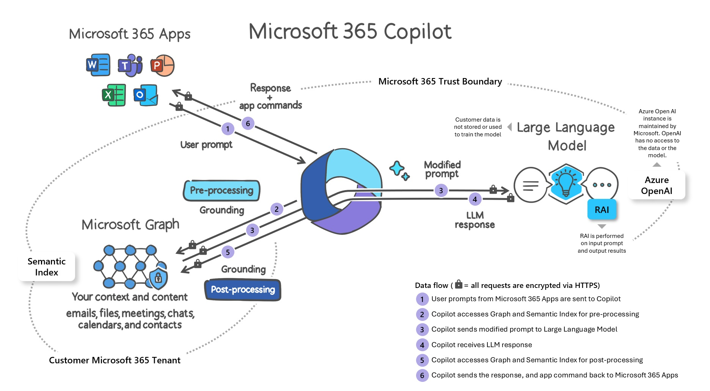
Copilot 365

Slide 9
1 minute crash course on completion chat api: roles and content
POST https://xxxxxx.openai.azure.com/openai/deployments/gpt-35-turbo-16k/chat/completions?api-version=2023-05-15
Input: { .. {"role": "system", "content": "Answer in italian, no matter what the language of the question is"},
{"role": "user", "content": "Who won second world war?"}
.. }
Output: { … "message": {
"content": "Gli Alleati hanno vinto la seconda guerra mondiale.",
"role": "assistant"
}
..
}

Slide 10
1 minute crash course on completion chat api: conversation history
POST https://xxxxxx.openai.azure.com/openai/deployments/gpt-35-turbo-16k/chat/completions?api-version=2023-05-15
Input: { .. {"role": "system", "content": "Answer in italian, no matter what the language of the question is"},
{"role": "user", "content": "Who won second world war?"}
{"role": "assistant", "content": " Gli Alleati hanno vinto la seconda guerra mondiale "}
{"role": "user", "content": "and who lost it?"}
.. }
Output: { … "message": {
"content": "Le potenze dell'Asse (Germania, Italia e Giappone) hanno perso la seconda guerra mondiale.
", "role": "assistant" }
..
}

Slide 11
What is function calling
It's a functionality available in the completion-chat api endpoint starting from
Gpt-3.5 turbo 0613
Gpt-4-0613
"embedded/abstracted" into tools-calls in gpt-3.5 1106 and gpt-4 1106 (and above)
Allows to have ChatGPT convert human natural query and commands/query into Json
Ai does not call an API, it's up to your code to do the call using the Json provided by the Ai

Slide 12
What is function calling.. continue
Along with user prompt send to chatGPT a list of functions definition (using Json schema syntax)
a signature with description of the goal of the function and its parameters (e.g. : temperature given a town name)
Json schema syntax is part of the OpenApi specification to define input and output dtos

Slide 13
{
"functions" : [
{
"name": "get-weather",
"description": "Get the current weather",
"parameters": {
"type": "object",
"properties": {
"location": {
"type": "string",
"description": "The city or state the user want to know the current weather. IMPORTANT : Assistant must ask the user a value for location if not provided in the conversation. Assistant MUST NOT make up one",
}
},
"required": ["location"]
},
}
]
Note: no need to document the corresponding output

Slide 14
- user : "how is the weather today?"
end-user
your app
chat-gpt
your weather api
- function: get-weather {…} - user : "how is the weather today?"
A: Please specify the location
- function: get-weather {…} - conversation history - user: "London "
A: function "get-weather" { "location" : "London" }
api call : https://../api/weather/ { "location" : "London" }
api reply : { "location" : "London" , "weather" : "rainy", temperature : "17" }
function: none conversation history Api reply : { "location" : "London" , "weather" : "rainy", temperature : "17" }
A: Today in London is rainy, with a temperature of 17 degrees

Slide 15
DEMO
Ask current and past weather

Slide 16
Api design for function calling
Extract function call "Json schema" dynamically from the open api document of your target api
Put clear description on input dto and its properties (prompt engineer applied on a swagger doc ☺)
Document required properties
Make sure enums are exposed in the swagger doc as strings
Make sure enums as strings are accepted as input at run time

Slide 17
Api design for function calling.. continue
Validate the input with care (fluent validation)
Return errors in Json format, stating clearly each property having problem and the action to take
Your validation code must be conversational, suggesting action to the chatbot, e.g.
Given this requirements the api you target the call will be likely a proxy to an actual existing api.
ret.Errors.Add(new ValidationFailure(propertyName,
(new ValidationErrorInfo { ErrorCode = $"ambiguous value for {propertyName}"
AssistantAction = $"reply to the user with these exact words: \"choose among the following values for {propertyName} : {string.Join(',',candidatePorts.Take(5).Select(FormatPort))}\"" }.ToJson())));

Slide 18
gotchas
The AI sometime make up parameters (e.g. : email)
Do not expect that required setting is always respected for the properties
Put up a good system message

Slide 19
DEMO
List, Create quotes in mymsc

Slide 20
Tools-calls
Available starting from gpt-3.5 1106 and gpt-4 1106
Function calls have become "deprecated": they have become a possible tool-type value for tools-calls
Tools are an abstraction to accommodate different "external data sources"
Currently "function" is the only tool type supported in chat-completion api
Chatgpt can return a reply with more than one tool call
Assistant api have similar concept but support more tools
Functions, Code interpreter, Knowledge Retrieval (RAG)
Still in beta, deserve a dedicated session

Slide 21
tools = [ { "type": "function", "function": { "name": "get_current_weather", "description": "Get the current weather", "parameters": { "type": "object", "properties": { "location": { "type": "string", "description": "The city and state, e.g. San Francisco, CA" } }, "required": ["location"] }, } }, { "type": "function", "function": { "name": "get_n_day_weather_forecast", "description": "Get an N-day weather forecast", "parameters": { "type": "object", "properties": { "location": { "type": "string", "description": "The city and state, e.g. San Francisco, CA"}, "num_days": {"type": "integer", "description": "The number of days to forecast"} }, "required": ["location", "num_days"] }, } }, ]

Slide 22
Tools-calls
Along with the Json reply from the api, need to pass also the corresponding Json returned by the ai in previous step (used as input of the api call)
Each function call reply has got an id that must be "copied" to the corresponding api reply when passing the Json reply to the ai
Required to correlate input-output of each function call (since there could be more than one)

Slide 23
Call to Action
OpenAI function/tools calling documentation
https://platform.openai.com/docs/guides/function-calling
https://cookbook.openai.com/examples/how_to_call_functions_with_chat_models
Azure OpenAI client library for .NET
https://github.com/Azure/azure-sdk-for-net/blob/main/sdk/openai/Azure.AI.OpenAI/README.md

